Slide 1

Transport Data Analysis
Presented By: Jurgen Tan

Slide 2
URLs
COE Results : https://data.gov.sg/dataset/coe-bidding-results
Driving Licence: https://data.gov.sg/dataset/driving-licence-information-qualified-driving-licence-holders
HDB Carpark https://data.gov.sg/dataset/hdb-carpark-information
Notes:
Cost Of Owning A Vehicle is it due to the increasing of license holders and if there are more vehicles on the road, is the HDB increasing the number of parking lots?

Slide 3
Enrolment, Intake & Graduation Dataset
3 Datasets
All The Local Tertiaries’ Data
Same Column Names
1982 to 2018

Slide 4


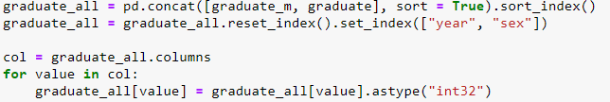
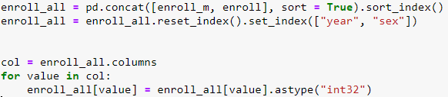
Enrolment, Intake & Graduation Data Preparation
Enroll & Intake: 1982 to 2014
Graduate: 1986 to 2016
Calculating the Male data
Standardizing to “int32”

Slide 5
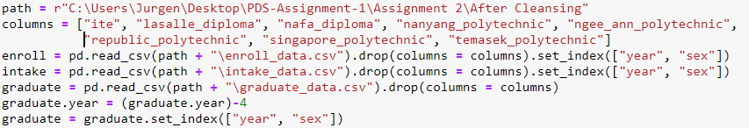

Enrolment, Intake & Graduation Concatenation
3 Datasets
All Local Tertiaries’ Data
Same Column Names
1982 to 2018

Slide 6
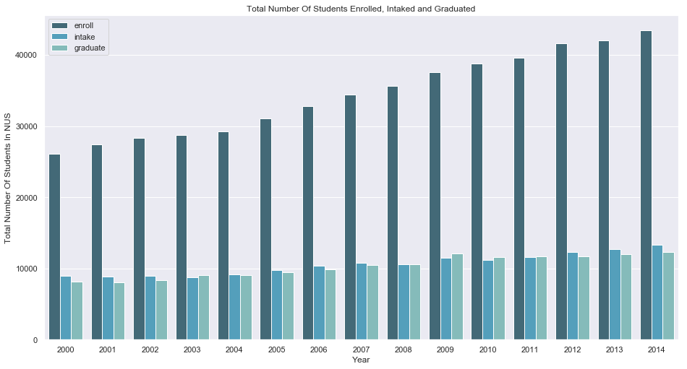
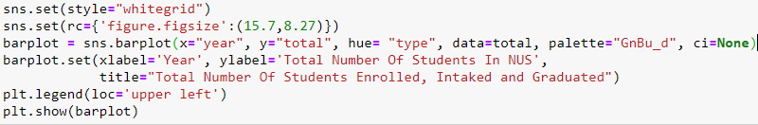
Total Number Of Students Enrolled, Intaked and Graduated
Uprising trend of Enrollment
Marginal increase in Intake
Almost constant difference in Graduation
Notes:
When Is The Best Month To Buy A Car

Slide 7
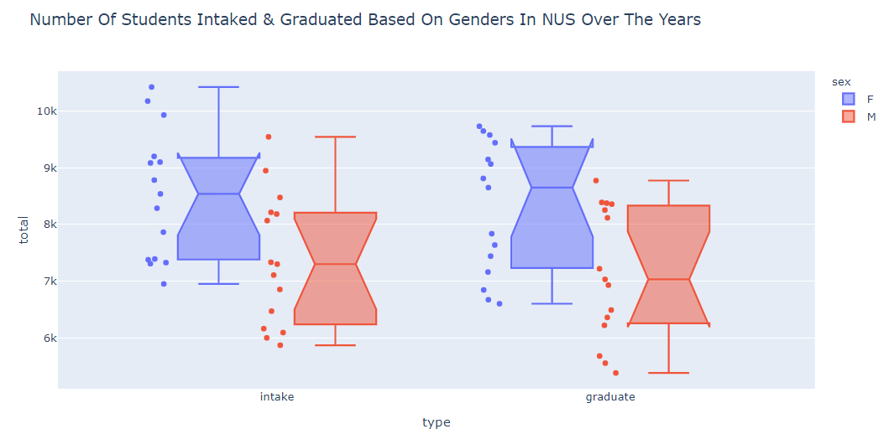
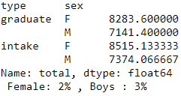
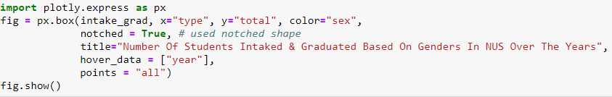
Number Of Students Intaked & Graduated Based On Genders Over The Years
Female > Male
Higher dropout % for Males
Notes:
Price Range For The COE Of Larger Cars

Slide 8
Overseas University Dataset
Categorised by field
In thousands
Only Year 2015

Slide 9
Overseas University Dataset Preparation
Notes:
Bids Received == COE Cost?

Slide 10

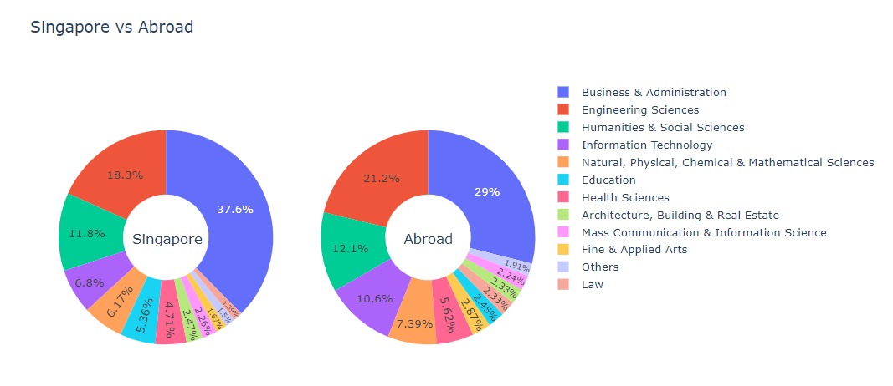
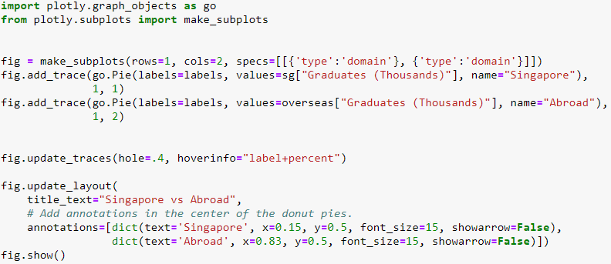
Fields Chosen From Local & Overseas Universities
Negative Gradient, Harsh Decline
2 Outliers
Lower Bids = Higher COE Price
Notes:
Bids Received == COE Cost?

Slide 11
Industry Chosen For First Degree Dataset
1993 to 2014

Slide 12
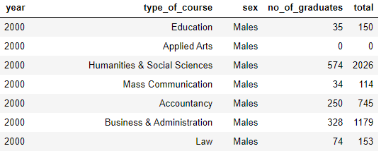
Industry Chosen For First Degree Data Preparation
2000 to 2014
Fill NA values with 0
Sum of Male & Female
Notes:
Bids Received == COE Cost?

Slide 13
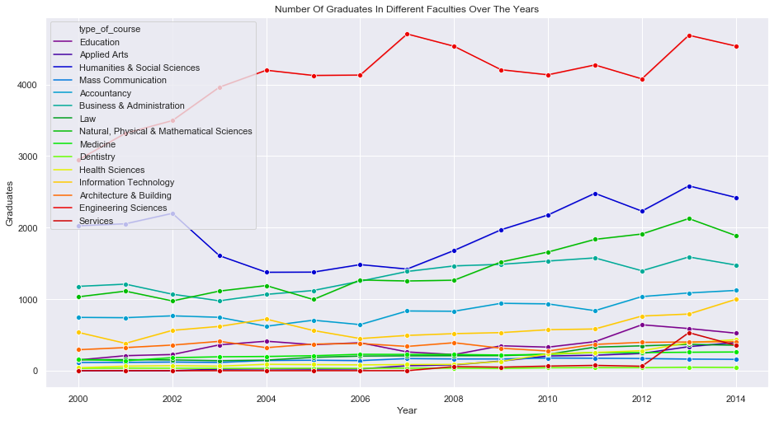
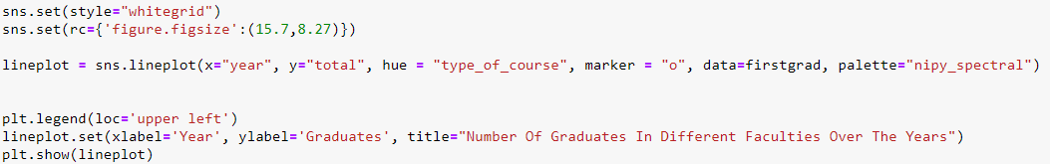
Fields Chosen From Local & Overseas Universities
Science courses have the most graduates
Also the biggest faculties
Notes:
Bids Received == COE Cost?

Slide 14
Employment Rate Dataset
2013 to 2017
Employment Rate
Gross & Basic Salary

Slide 15

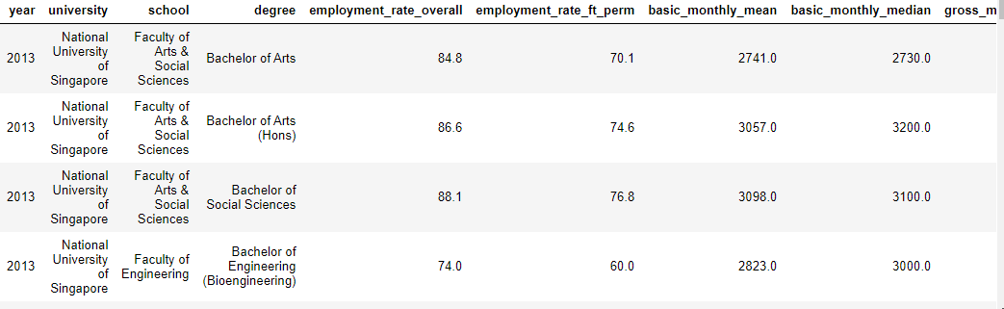
Employment Rate Data Preparation
Only NUS
Based on the top 3 fields chosen
Notes:
Bids Received == COE Cost?

Slide 16
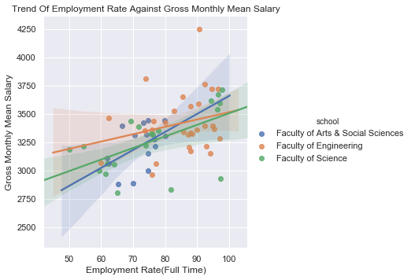
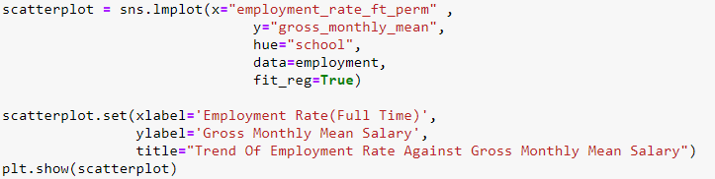
Relationship Between The Employment Rate Against Gross Monthly Mean Salary
Notes:
Bids Received == COE Cost?

Slide 17
Conclusion
Notes:
The increase of COE prices is not because of the number of driving licenses and that the government does have many high levelled MSCPs built in already.

Slide 18
Thank You
Notes:
The increase of COE prices is not because of the number of driving licenses and that the government does have many high levelled MSCPs built in already.

